Slide 1
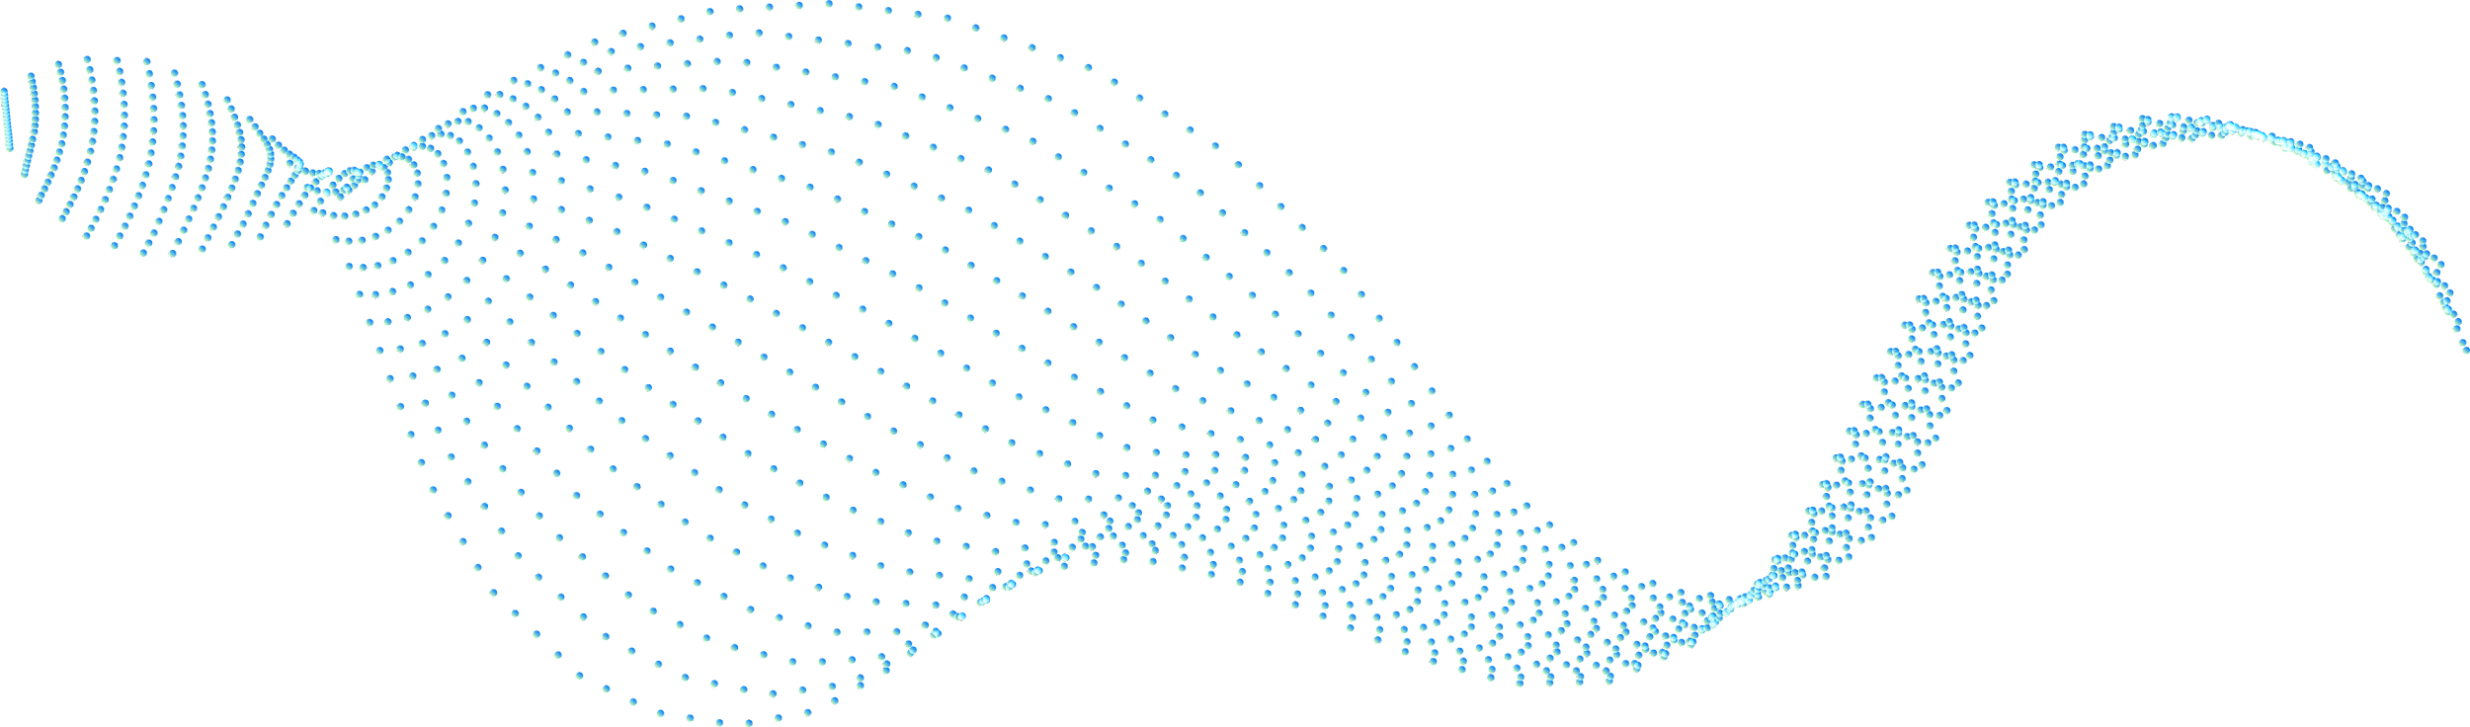
CHATBOT USING NLP FOR IMPAIRED PEOPLE
AID IN WRITING AND UNDERSTANDING COMPOSITIONS
Team Members :
PABBATHI B L SHREE HARSHA 20BCD7151
MARAMREDDY MEGHANA 20BCI7081
PRAKASH BADRINATHREDDY 20BCI7041

Slide 2
Abstract
This article presents a solution for visually impaired students who face difficulties in studying text and electronic documents. An experimental prototype is developed using NLP techniques to assist the blind community with information access. The chatbot employs techniques such as automatic index generation, paraphrasing, summarizing, passage retrieval, and query rewriting. The chatbot uses tools such as Torch, Sentence piece, Newspaper3k, and the Natural Language Toolkit to achieve its goals.
The proposed software aims to reduce the time required for writing and understanding compositions, making information access easier for visually impaired students and other people.
Automatically generate useful information on any topic with a few clicks and words.
Developed to make life easier for the blind community.
Powered by advanced NLP techniques and WordNet-based query rewriting, so you get relevant results in no time.
Get access to the right info with ease, as it is read aloud to you. No need for complicated navigation anymore.

Slide 3
Need of proposed Work
This article presents a solution for visually impaired students who face difficulties in studying text and electronic documents. An experimental prototype is developed using NLP techniques to assist the blind community with information access. The chatbot employs techniques such as automatic index generation, paraphrasing, summarizing, passage retrieval, and query rewriting. The chatbot uses tools such as Torch, Sentence piece, Newspaper3k, and the Natural Language Toolkit to achieve its goals.
The proposed software aims to reduce the time required for writing and understanding compositions, making information access easier for visually impaired students and other people.
Automatically generate useful information on any topic with a few clicks and words.
Developed to make life easier for the blind community.
Powered by advanced NLP techniques and WordNet-based query rewriting, so you get relevant results in no time.
Get access to the right info with ease, as it is read aloud to you. No need for complicated navigation anymore.

Slide 4
Proposed Architecture
INPUT
PROCESSING
OUTPUT
Text to Speech
Automatic index generation.
Paraphrasing summarizer.
Passage retrieval.
Query rewriting.
Voice Enabled to read out the generated output

Slide 5
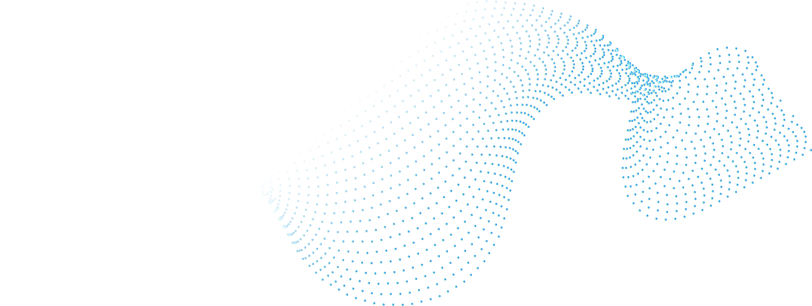

System requirements
Processor: Intel i3 9th gen(Min)
Ram: 4GB DDR4
Internet Connectivity
OS: Windows 7+
Language : Python
Libraries used : nltk, wordnet, pyTorch, openai, pyttsx3, speech_recognition, flask

Slide 6
Proposed Work
An AI-BOT is an artificial intelligence-based system that can simulate human conversation and provide automated responses to queries. The proposed work on an AI-BOT aims to develop a conversational agent that can assist users in various tasks such as answering queries, booking appointments, and providing recommendations.
The AI-BOT will be designed using natural language processing (NLP) techniques and machine learning algorithms. The system will analyze user queries and generate appropriate responses based on the context and intent of the question. The AI-BOT will also be trained on a large dataset of conversational data to improve its understanding of natural language and improve its response accuracy.
The proposed work on the AI-BOT will involve several stages. The first stage will be the development of the AI-BOT architecture, which will involve selecting the appropriate NLP techniques, machine learning algorithms, and other tools required for the development of the AI-BOT.

Slide 7
Existing Problem
Natural Language Understanding (NLU): Improving an AI bot's capacity to comprehend natural language input is one of the field's greatest difficulties. The inability of current AI bots to comprehend nuanced language and complicated sentences makes it challenging for them to deliver responses that are correct and pertinent.
Contextual Awareness: Creating AI chatbots that can comprehend the context of a conversation is another difficulty. For instance, in order to respond appropriately to a user's request to "find a good restaurant," a bot must be able to comprehend the user's location, tastes, and dietary requirements.
Personalization: AI bots must be able to adapt their responses to each user according to their preferences, history, and other considerations. Data analysis and powerful machine learning algorithms are needed for this.

Slide 8
BASE PAPER
The base paper on AI-BOT is titled “A chatbot system to support visually impaired students: a pilot experiment“. It was published in a peer-reviewed journal and proposes a framework for building an AI-BOT that can simulate human-like conversations and provide automated responses to user queries.The paper starts by providing an overview of conversational agents and their importance in various applications such as customer service, personal assistants, and healthcare. It then discusses the limitations of existing conversational agents and proposes a solution to address these limitations by developing an AI-BOT that uses natural language processing techniques and machine learning algorithms.
C:\Users\Harsha\Downloads\chatbot-paper.pdf

Slide 9
Related Work
The existing tools provide text annotation tools, such as bookmarking, note taking, or outlining facilities. However, these facilities are often crude. For example, the user often cannot directly go to the position of a bookmark in the original document (through a hyperlink, for example), or integrate bookmarks into existing outlines; thus limiting his access.
NLP techniques used to improve the reading and writing tasks of the visually handicapped include word prediction and homonym checking. Word prediction allows the application to predict the most likely word to be typed given the previous context. The user types a letter and the program offers a list of the most likely words beginning with that letter. If the required word is on the list, it can be quickly selected. If the word is not on the list, typing the next letter will bring up a different choice and so on. Homonym support provides auditory and visual reinforcement of commonly confused like-sounding words. To avoid the confusion between homophones, the program colour codes confusable words and lists possible alternatives with audible definitions and sample sentences.

Slide 10
Conclusion
In general, students with any special needs have faced many obstacles to achieve space and recognition in the job market. However, unfortunately, very few students can realize this desire which makes this research an essential step in helping these people. It aims to provide people with special needs more independence, quality of life, and social inclusion by improving their skills and learning. In this paper, we propose a chatbot to support and improve the teaching of visually impaired students. Herein, the idea is not to replace screen reading tools used by visually impaired people. We aim for a system as an additional tool and a mechanism for teachers to embed content and provide it to the students.
It can do:
Paraphrasing
Summarizing
Query Indexing
Passage Retreval etc….

Slide 11
References
G. A. Miller. The magical number seven, plus or minus two: Some limits on ourcapacity for processing information. Psychological Review, 63:81–97, 1956.Google Scholar
CSUN’s 20th Annual International Conference “Technology and Persons with Disabilities”, Los Angeles, March 2005.
"Design and Implementation of an Intelligent Chatbot for Visually Impaired People Using NLP and AI" by R.S. Vinothini, G. Sasikala, and K. Shankar. International Journal of Emerging Trends & Technology in Computer Science, Volume 6, Issue 5, September-October 2017. DOI: 10.31142/ijettcs.6.5.09
"Chatbots for Blind People: A Systematic Literature Review" by Renato Fileto, Karla Figueiredo, and Adriano Cansian. In Proceedings of the 2018 IEEE 32nd International Conference on Advanced Information Networking and Applications (AINA), pages 888-895, Krakow, Poland, May 16-18, 2018. DOI: 10.1109/AINA.2018.00092
"An Intelligent Chatbot System for Visually Impaired People Using Natural Language Processing" by Ahmed Mustafa and Ahmed Salah. In Proceedings of the 2020 3rd International Conference on Computer Applications & Information Security (ICCAIS), pages 1-6, Riyadh, Saudi Arabia, March 1-2, 2020. DOI: 10.1109/ICCAIS48318.2020.9131088

Slide 12
References
"Design and Implementation of a Conversational Agent for Visually Impaired People Using NLP and AI Techniques" by S.S. Sathishkumar and K. Duraiswamy. In Proceedings of the 2019 International Conference on Computational Intelligence and Knowledge Economy (ICCIKE), pages 1-6, Coimbatore, India, December 19-21, 2019. DOI: 10.1109/ICCIKE.2019.8903361
"A Chatbot System for Visually Impaired People Using NLP and Machine Learning" by Shagufta Sharif and Nasrin Akter. In Proceedings of the 2020 11th International Conference on Computing, Communication and Networking Technologies (ICCCNT), pages 1-6, Kharagpur, India, July 1-3, 2020. DOI: 10.1109/ICCCNT49239.2020.9225244
"A Chatbot-based System for Supporting the Visually Impaired through Natural Language Processing" by R. Raja, S. Anand, and S. S. Kumar, published in Procedia Computer Science in 2018.

Slide 13
THANKS!

